Slide 1

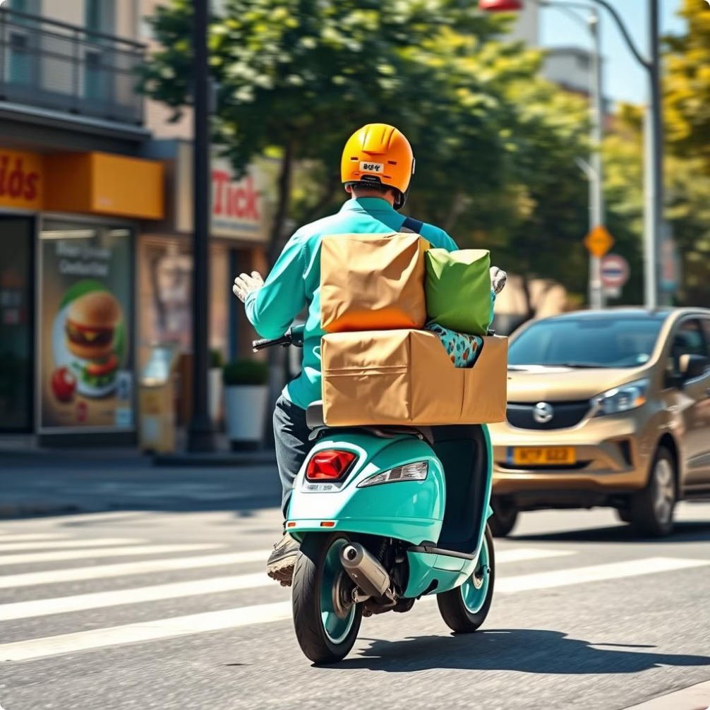
Food Ninja:
Your healthy fast food solution

Slide 2
Meet the Team
Muhammad Mustafa Fahd
Mohannad Mahmoud Hassan
Nadin Ahmed Elsandarousy
Mobile app developer
Mobile app developer
Mobile app developer

Slide 3
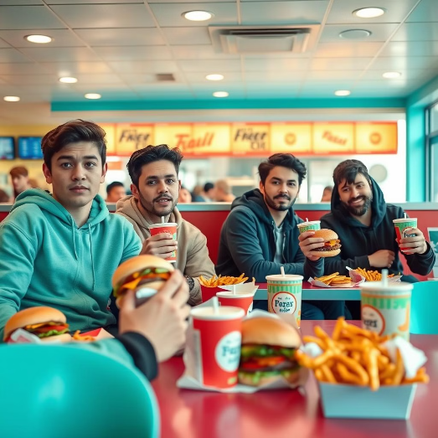

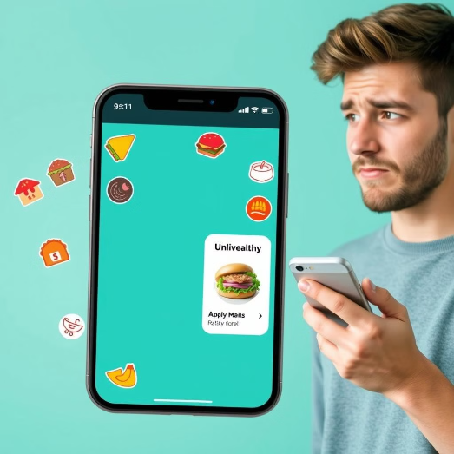
Problems
Unhealthy Fast Food Options
Limited Access to Nutritious Meals
Lack of Quick, Healthy Food Delivery

Slide 4
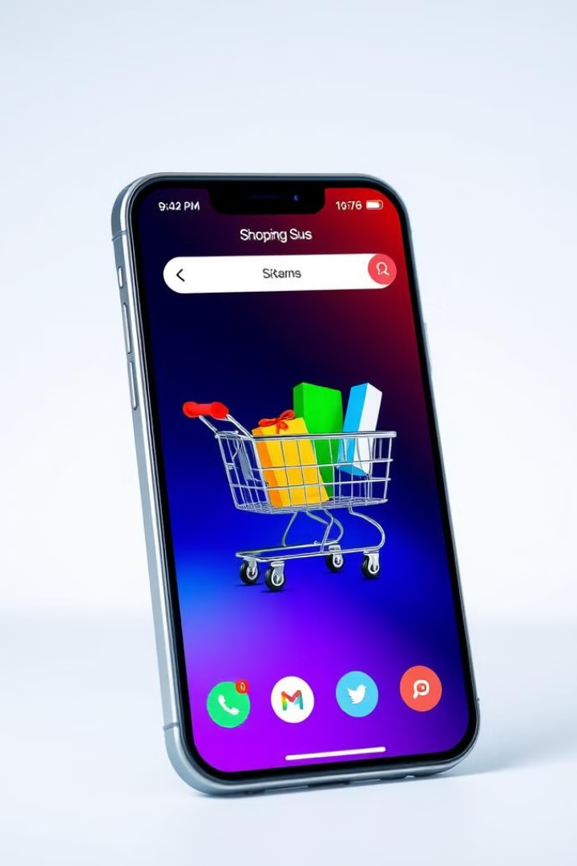
Revolutionizing the Healthy food Experience
The solution centers on providing convenient, nutritious alternatives to popular fast foods, ensuring that customers enjoy balanced versions of their favorite meals, such as burgers and pizza, made with wholesome ingredients. The app features a dedicated selection of healthy meals, easily accessible through a user-friendly interface, where each dish is curated to offer a balanced nutritional profile without sacrificing flavor. Additionally, a fast and reliable delivery service ensures that these healthy options arrive promptly, catering to busy schedules and making nutritious eating convenient and enjoyable for all users.

Slide 5

Application Screens

Slide 6
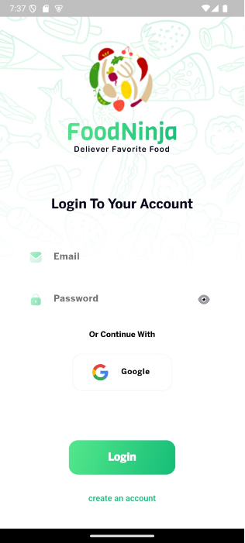
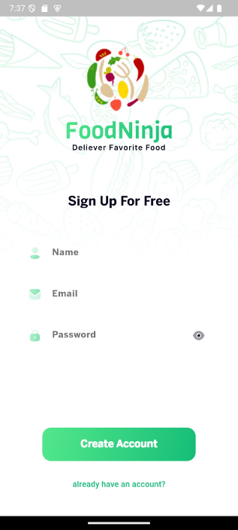
Authentication

Slide 7
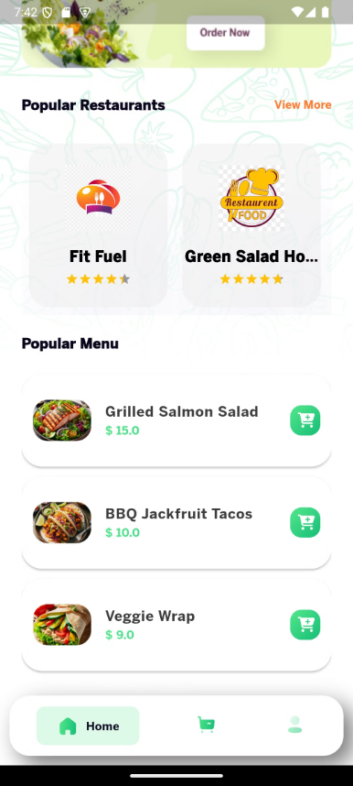
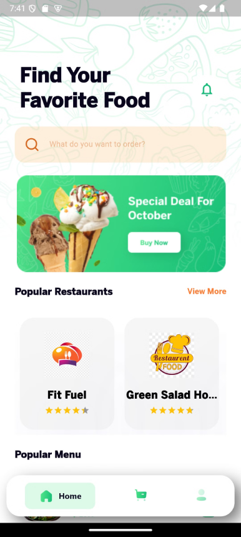
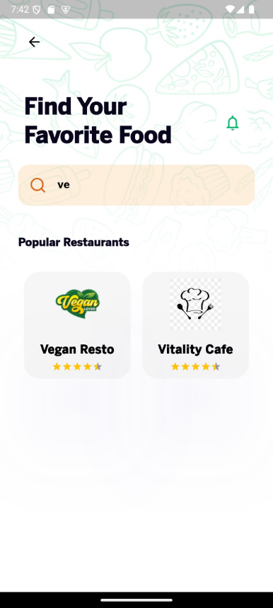
Home Screen

Slide 8
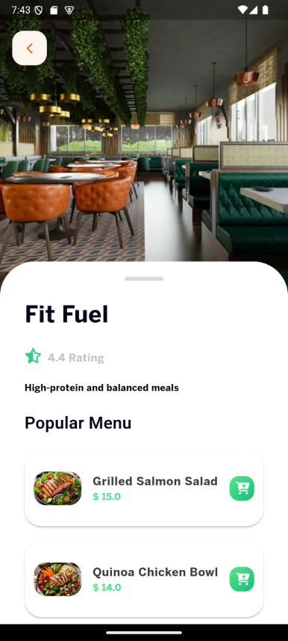
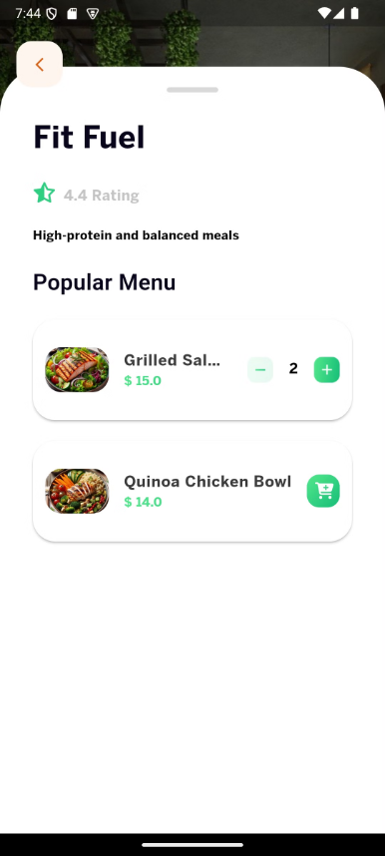
Restaurant

Slide 9
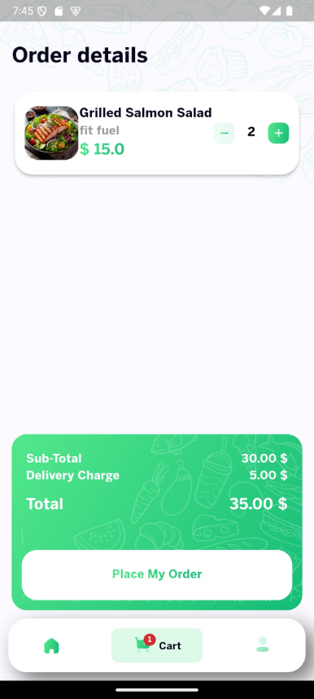
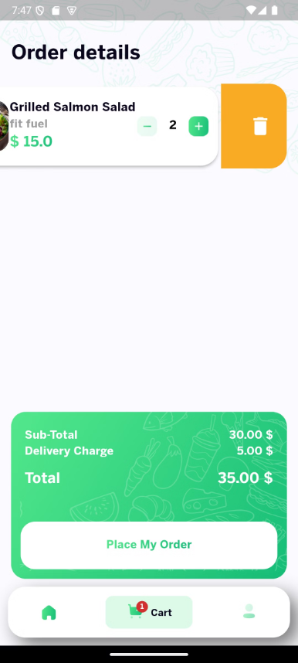
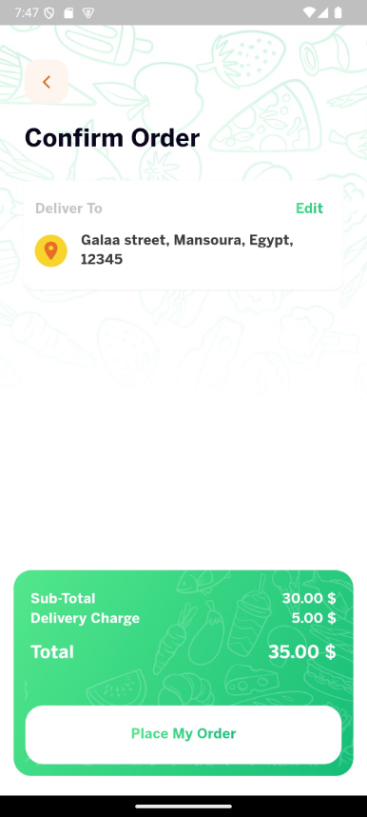
Cart

Slide 10





Technology Stack
Flutter
Bloc
Robust cross-platform mobile development framework.
Flutter state management tool that separates logic from UI.
Firebase
Some libraries
Database management
Go Router - Navigation
Remote file storage
Get it - Dependency Injection
Authentication
Paymob - Payment integration
Google OAuth

Slide 11
Thank You!
Any Questions?

